Slide 1

Are Newer Steam Games More Likely to Receive Positive User Reviews?
By Vicky Wu

Slide 2

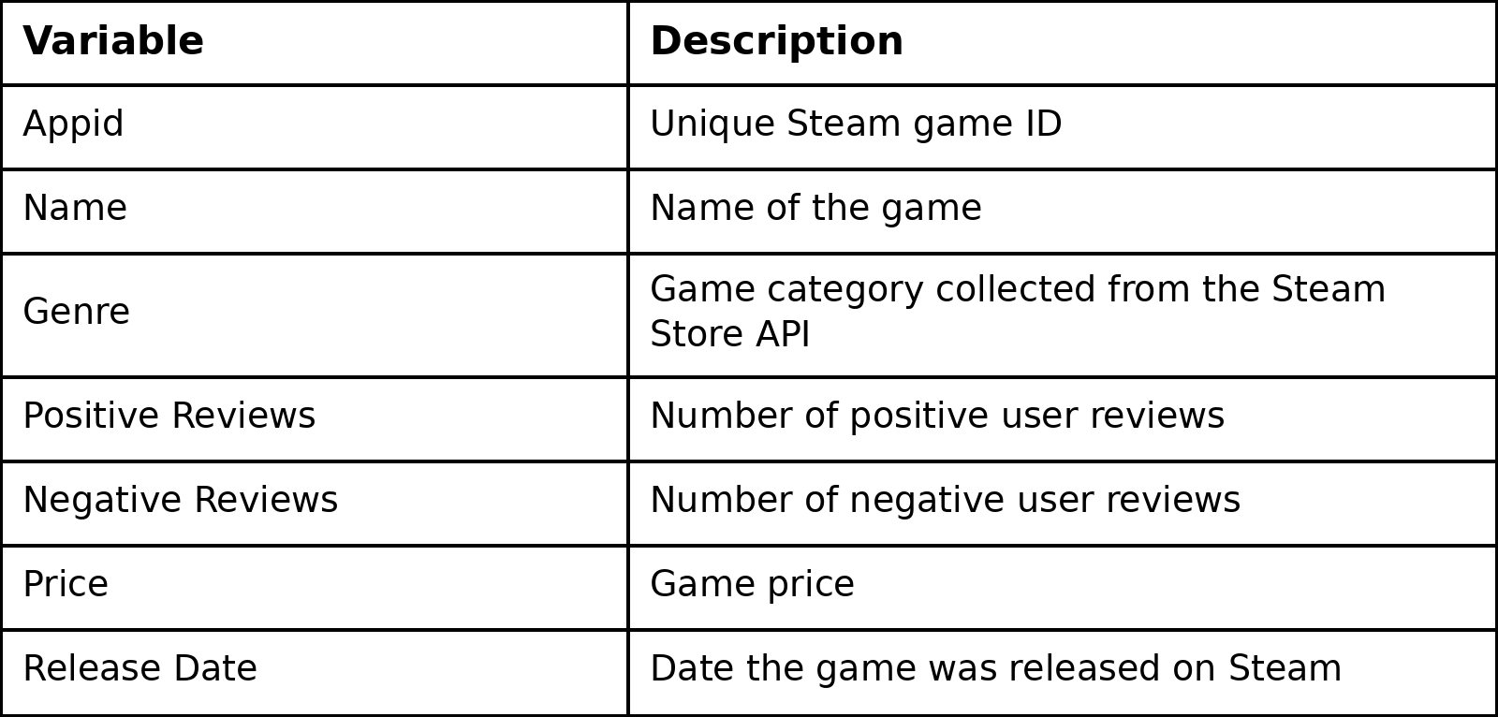
Research Question
Main Question: Are newer Steam games more likely to receive positive user reviews than older Steam games?

Slide 3

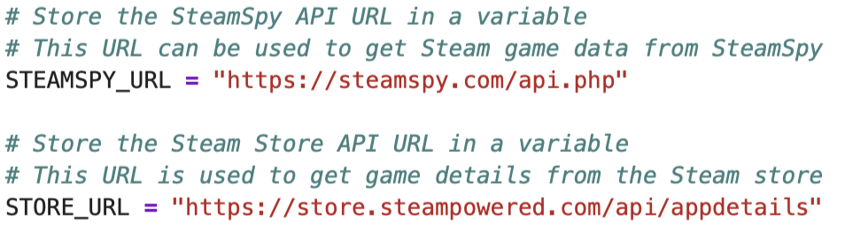
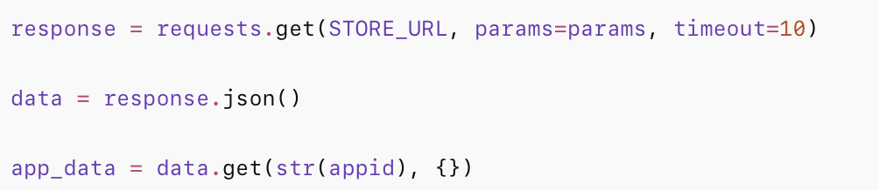
API Documentation

Slide 4

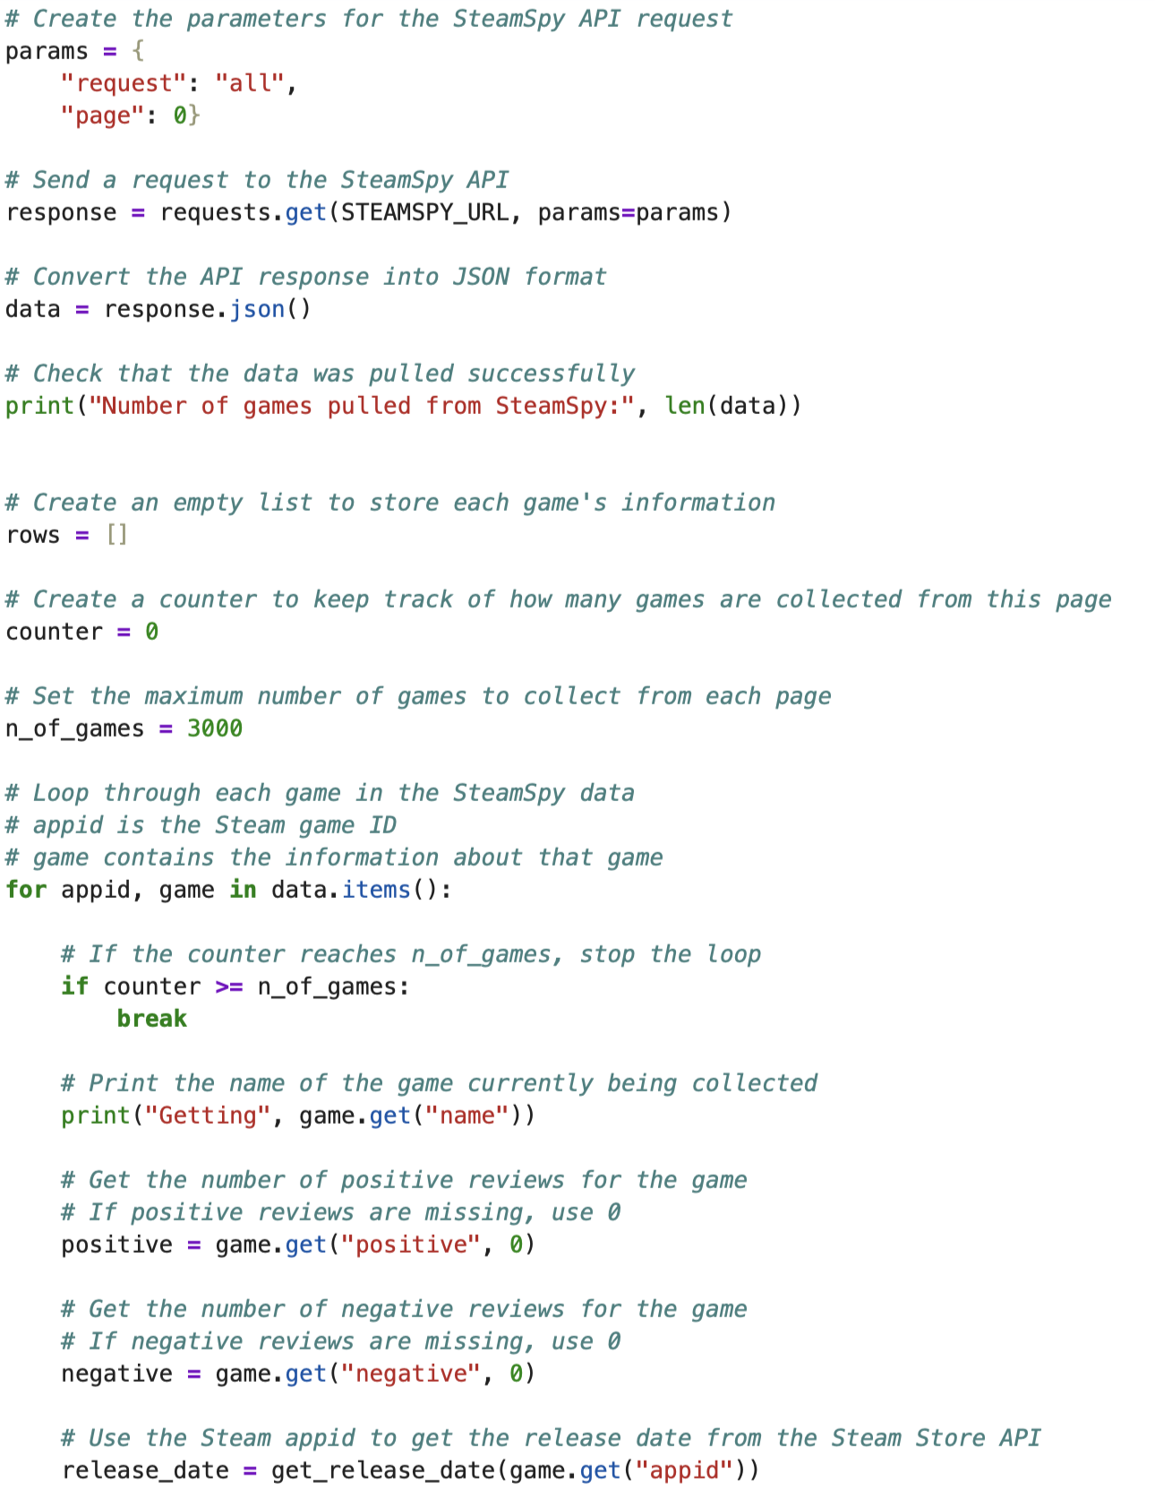
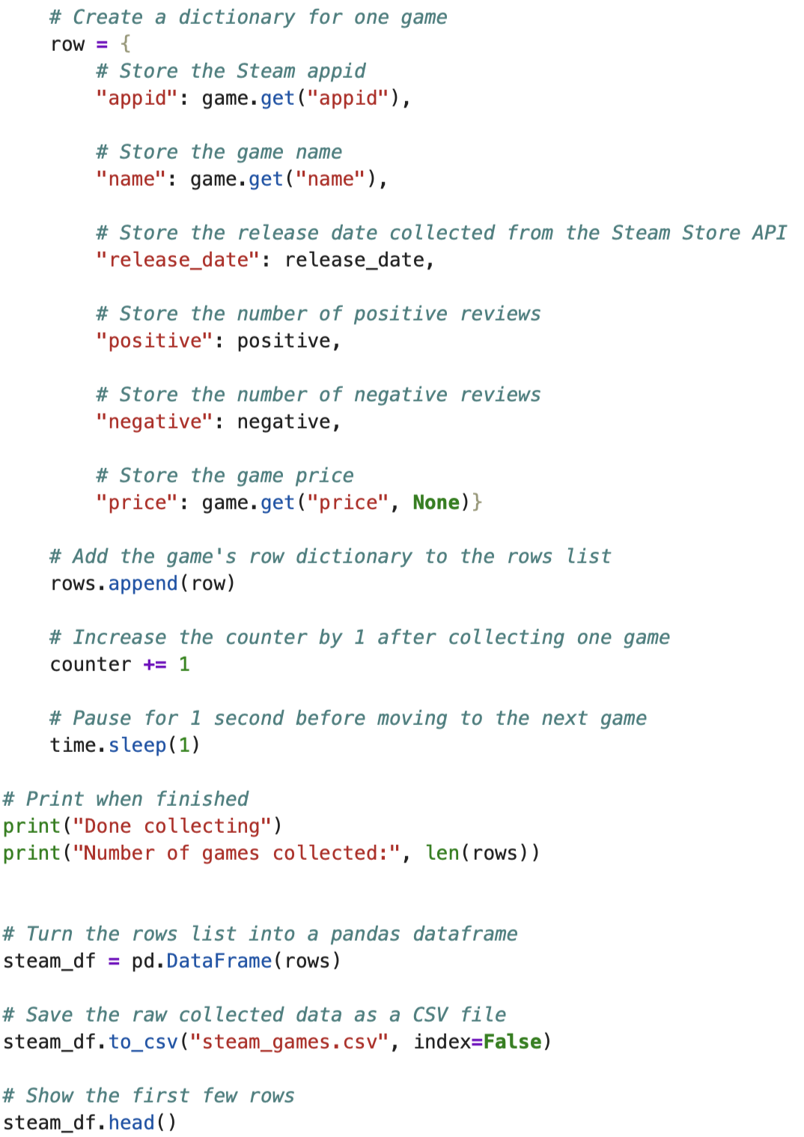
Data Collection Process

Slide 5

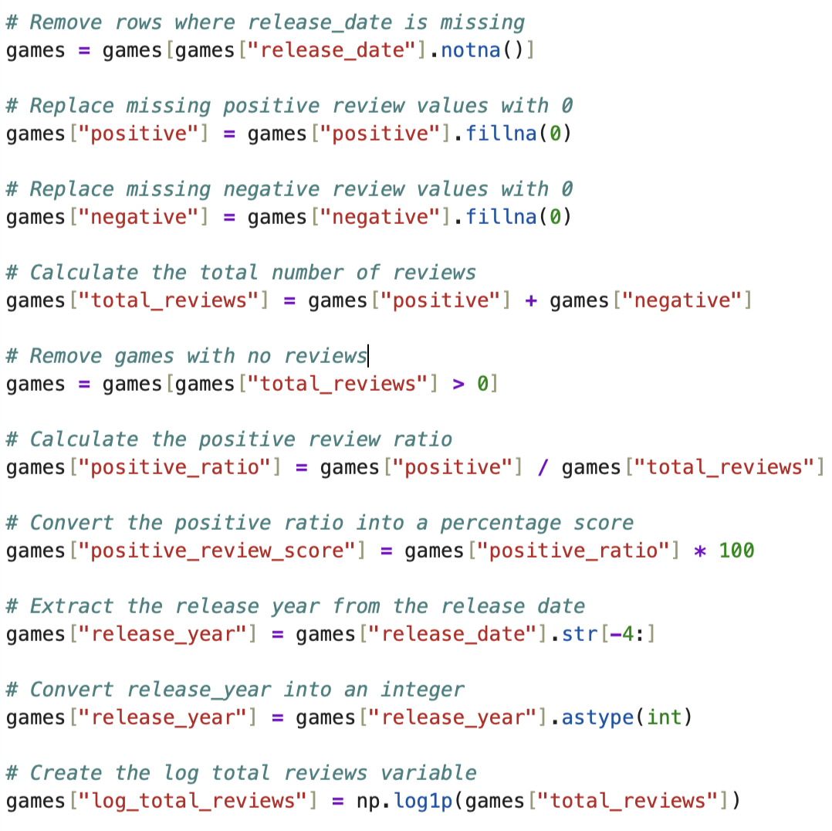
New Variables
Total Review
Positive Ratio
Release Year

Slide 6

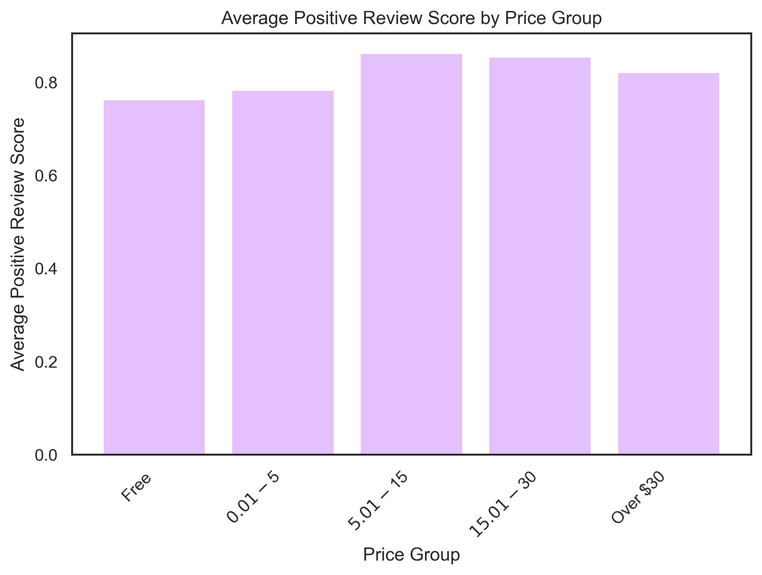
Graph 1
Games priced between $5.01 and $30 have the highest average positive review scores, while free games had the lowest average score.

Slide 7

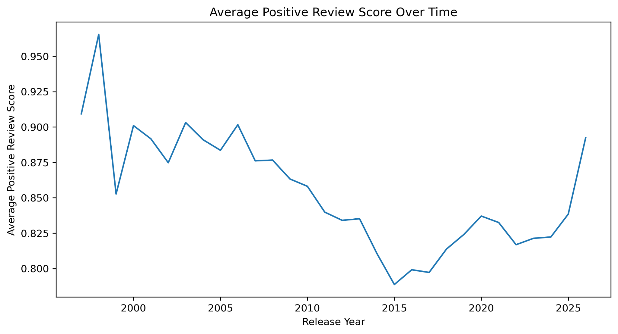
Graph 2
Average positive review scores declined from the early 2000s into the mid-2010s, then started to rise again after around 2016–2017.

Slide 8

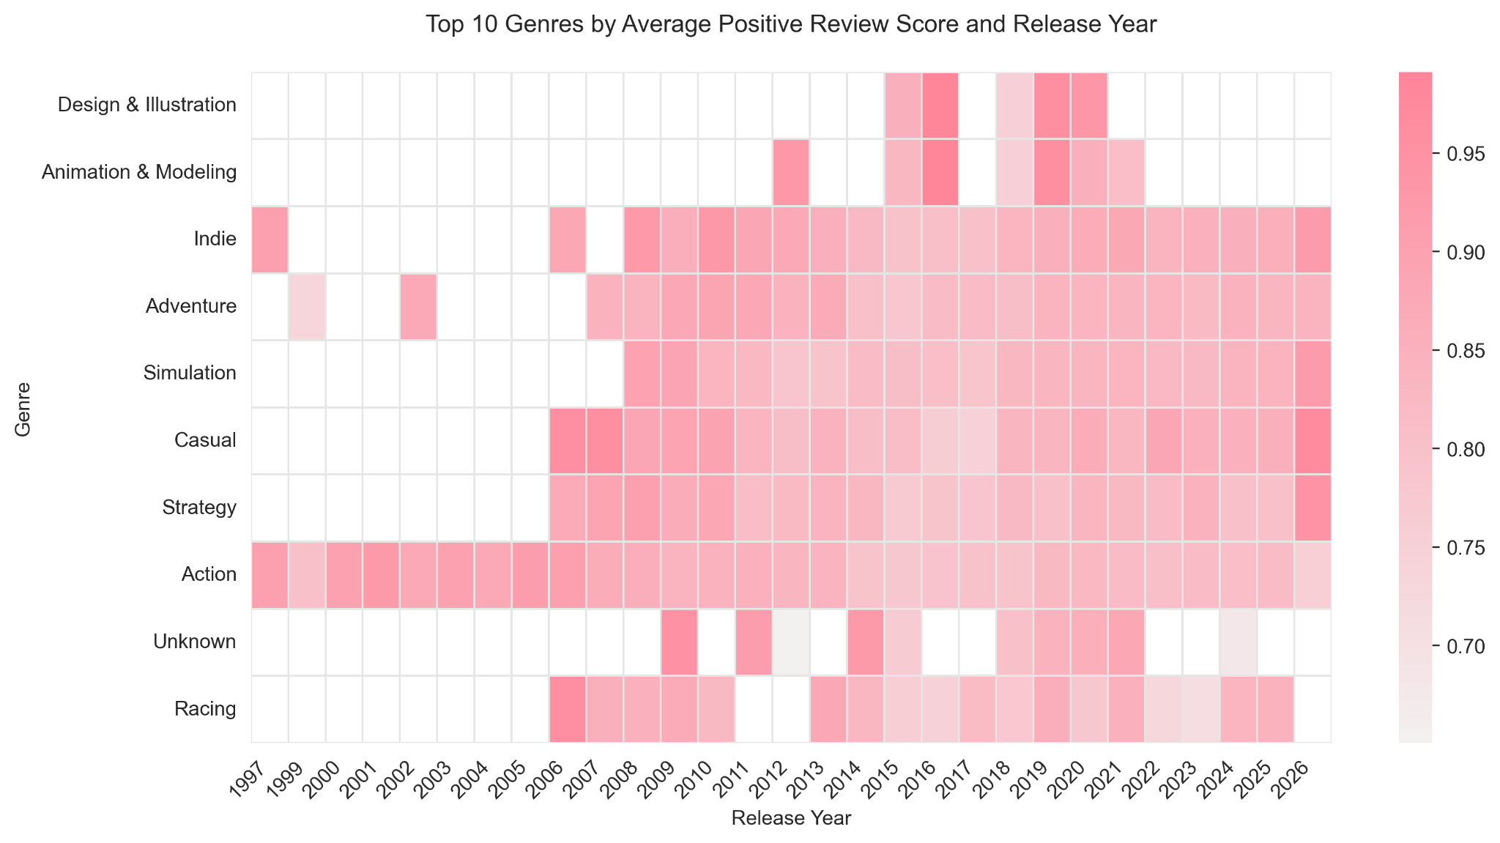
Graph 3
Genres like Indie, Adventure, Simulation, Casual, Strategy, and Action have more consistent positive review scores from around 2008 onward, while some genres have missing or less consistent data in earlier years.

Slide 9

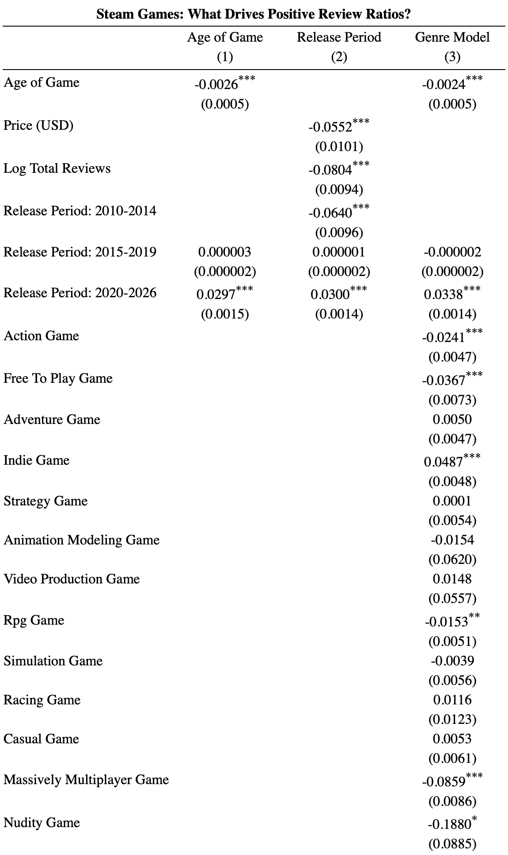
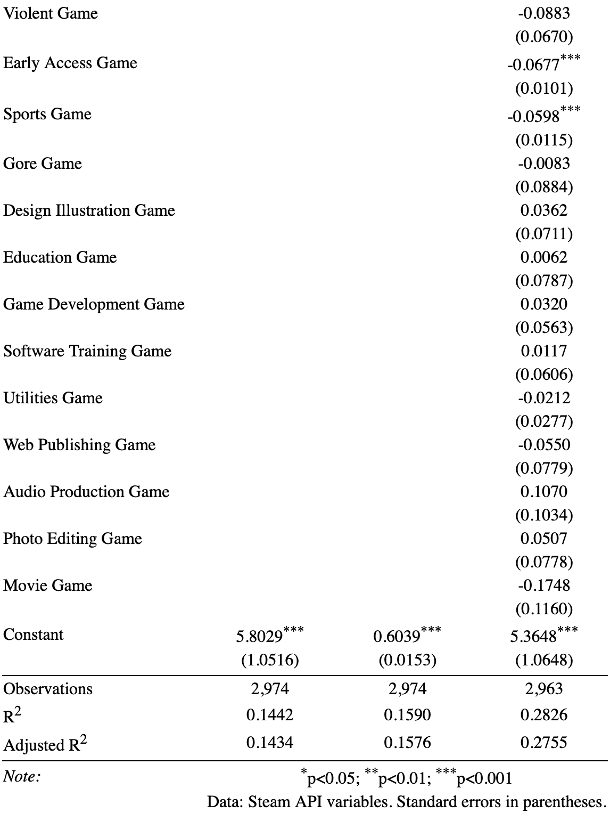
Regression Model

Slide 10

Regression Results
Model 1 show a coefficient is negative and statistically significant, which means newer games were not more likely to have higher positive review ratios of -0.0026. Meaning that Showing that each later release year, the positive review ratio is lower by about 0.26 percentage points, holding price and total reviews constant.
In Model 2 between 2010–2014 release period is negative and statistically significant at -0.0640 meaning that game in 2010–2014 has a 6.40 percentage points less likely to get positive review. However in 2020–2026 release period has a positive and is statistically significant at 0.0300, showing us that in those year game would have 3 percentage points more likely to get positive review.
Finally in Model 3 with several genre, there are couple of them that are statistically significant like the Indie games where they get about 4.87 percentage points higher positive review holding the other variables constant. But that not the case for other genres like Action games are about 2.41 percentage points lower, Free To Play games are about 3.67 percentage points lower, RPG games are about 1.53 percentage points lower, Massively Multiplayer games are about 8.59 percentage points lower, Early Access games are about 6.77 percentage points lower, and Sports games are about 5.98 percentage points lower.

Slide 11

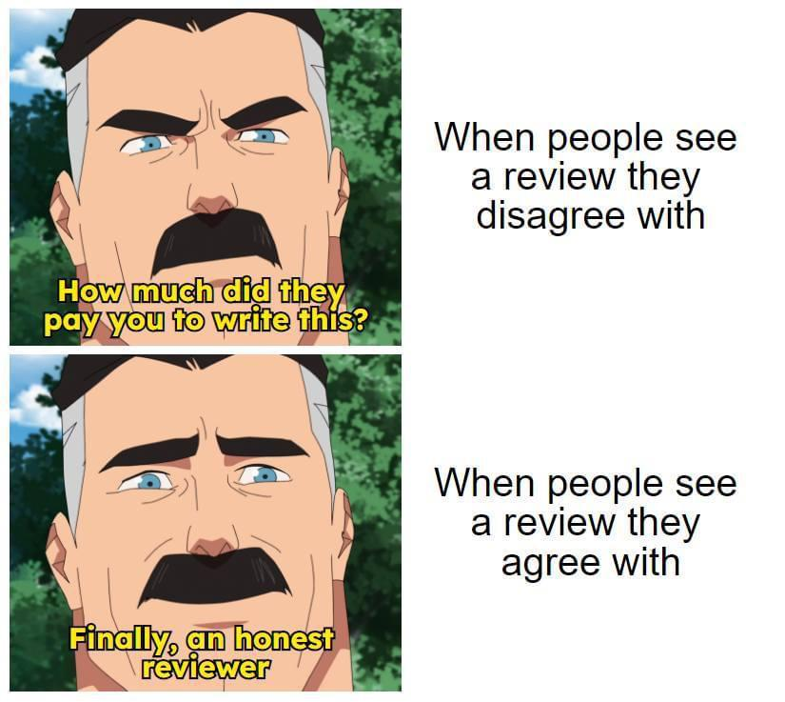
Conclusion
Main conclusion: Newer Steam games were not more likely to receive higher positive review scores in my data.
Key findings:
Older games, especially before 2010, had the highest average review scores.
Review scores declined around the mid-2010s.
Some genres had stronger average review scores than others.
Indie games were positively related to review scores in the regression.
The results show correlation, not definite causation.

